Slide 1
Project Title:
Cyclistic bike-share analysis
Technologies:
Data visualization - PowerBI
Domain:
Data analysis and Data visualisation
By - Sidharth (DM09)

Slide 2
1. Business task
You are a junior data analyst working in the marketing analyst team at Cyclistic, a bike-share company in Chicago.
The director of marketing believes the company’s future success depends on maximizing the number of annual memberships.
Therefore, your team wants to understand how casual riders and annual members use Cyclistic bikes differently.
From these insights, your team will design a new marketing strategy to convert casual riders into annual members.
But first, Cyclistic executives must approve your recommendations, so they must be backed up with compelling data insights and professional data visualizations.
You will use Cyclistic’s historical trip data to analyze and identify trends.

Slide 3
2. Description of the data source
The data has been made available by Motivate International Inc.

Slide 4
3. Documentation of any cleaning or manipulation of data
From the Date feature, the following features were derived:
Year
Quarter
Month
Day
Using Ride starting time & ending time:
duration of the rides were derived

Slide 5
4. A summary of your analysis
Casual riders are little lesser compared to that of membership holders
Electric bike users are few in numbers
Riders are maximum at around 6pm
The average ride duration is 6 to 8 minutes
Theater on the lake, Streeter Dr & grand awe - are the top 2 stations with the maximum no:of riders.

Slide 6
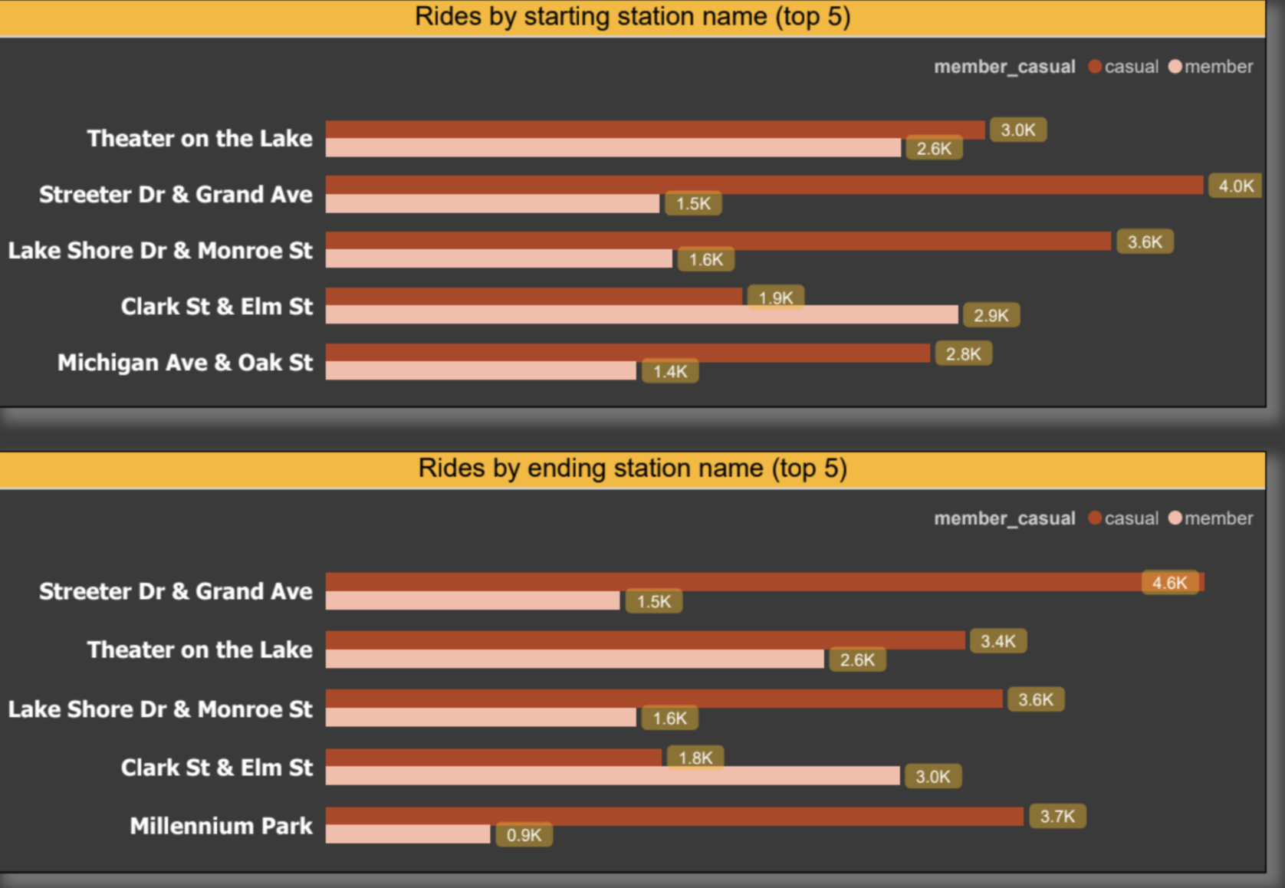
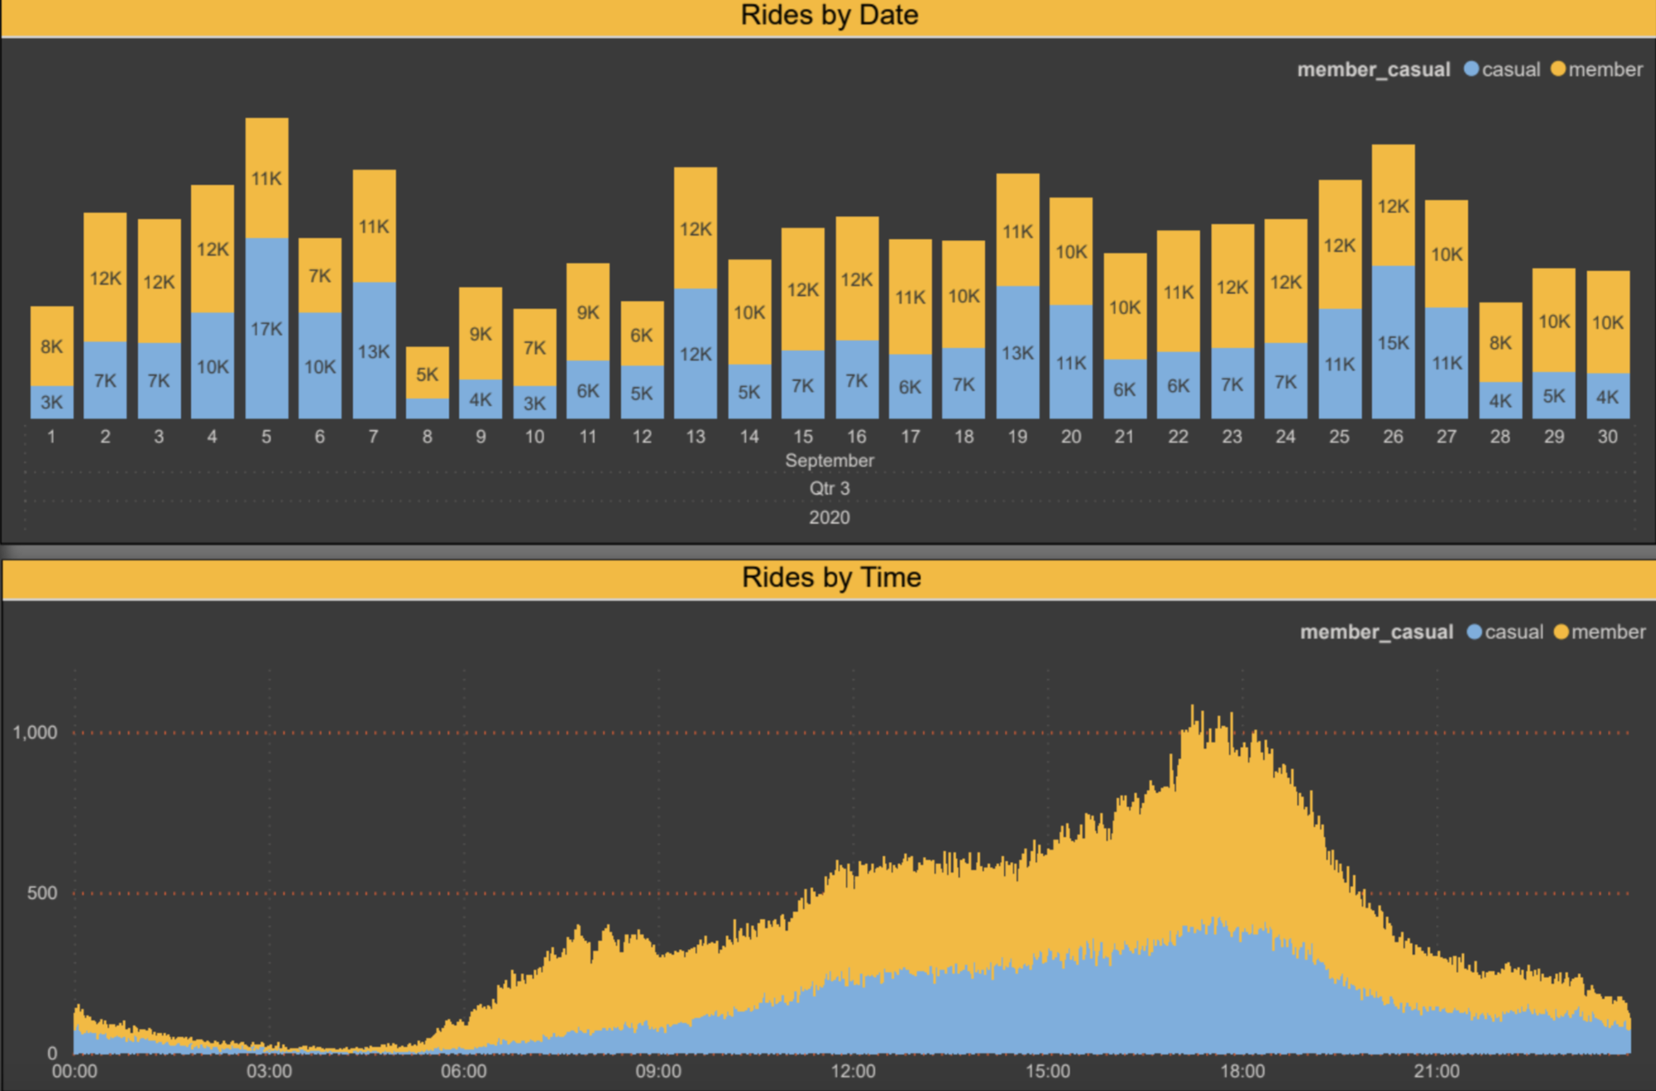
5. Supporting visualizations

Slide 7
6. Top three recommendations
In busy stations, casual riders are higher than membership riders, so steps should be taken to convert the casual riders.
Casual riders are more during peak hours. So, there is an opportunity to convert those casual riders into membership riders.
Marketing strategies can be used to convert casual riders into membership riders.

Slide 8
Thankyou

